Slide 1
CIS 4930/6930-002 Data Visualization
Descriptive Statistics and Visualization
Ghulam Jilani Quadri
University of South Florida
Slide credits D.A. Forsyth

Slide 2
Reminders
4/10/2018 – Project 7 Due
4/22/2018 – Paper 3 Review Due
4/15/2018 – Project 7 Peer Review Due
4/24/2018 – Project 8 Due

Slide 3
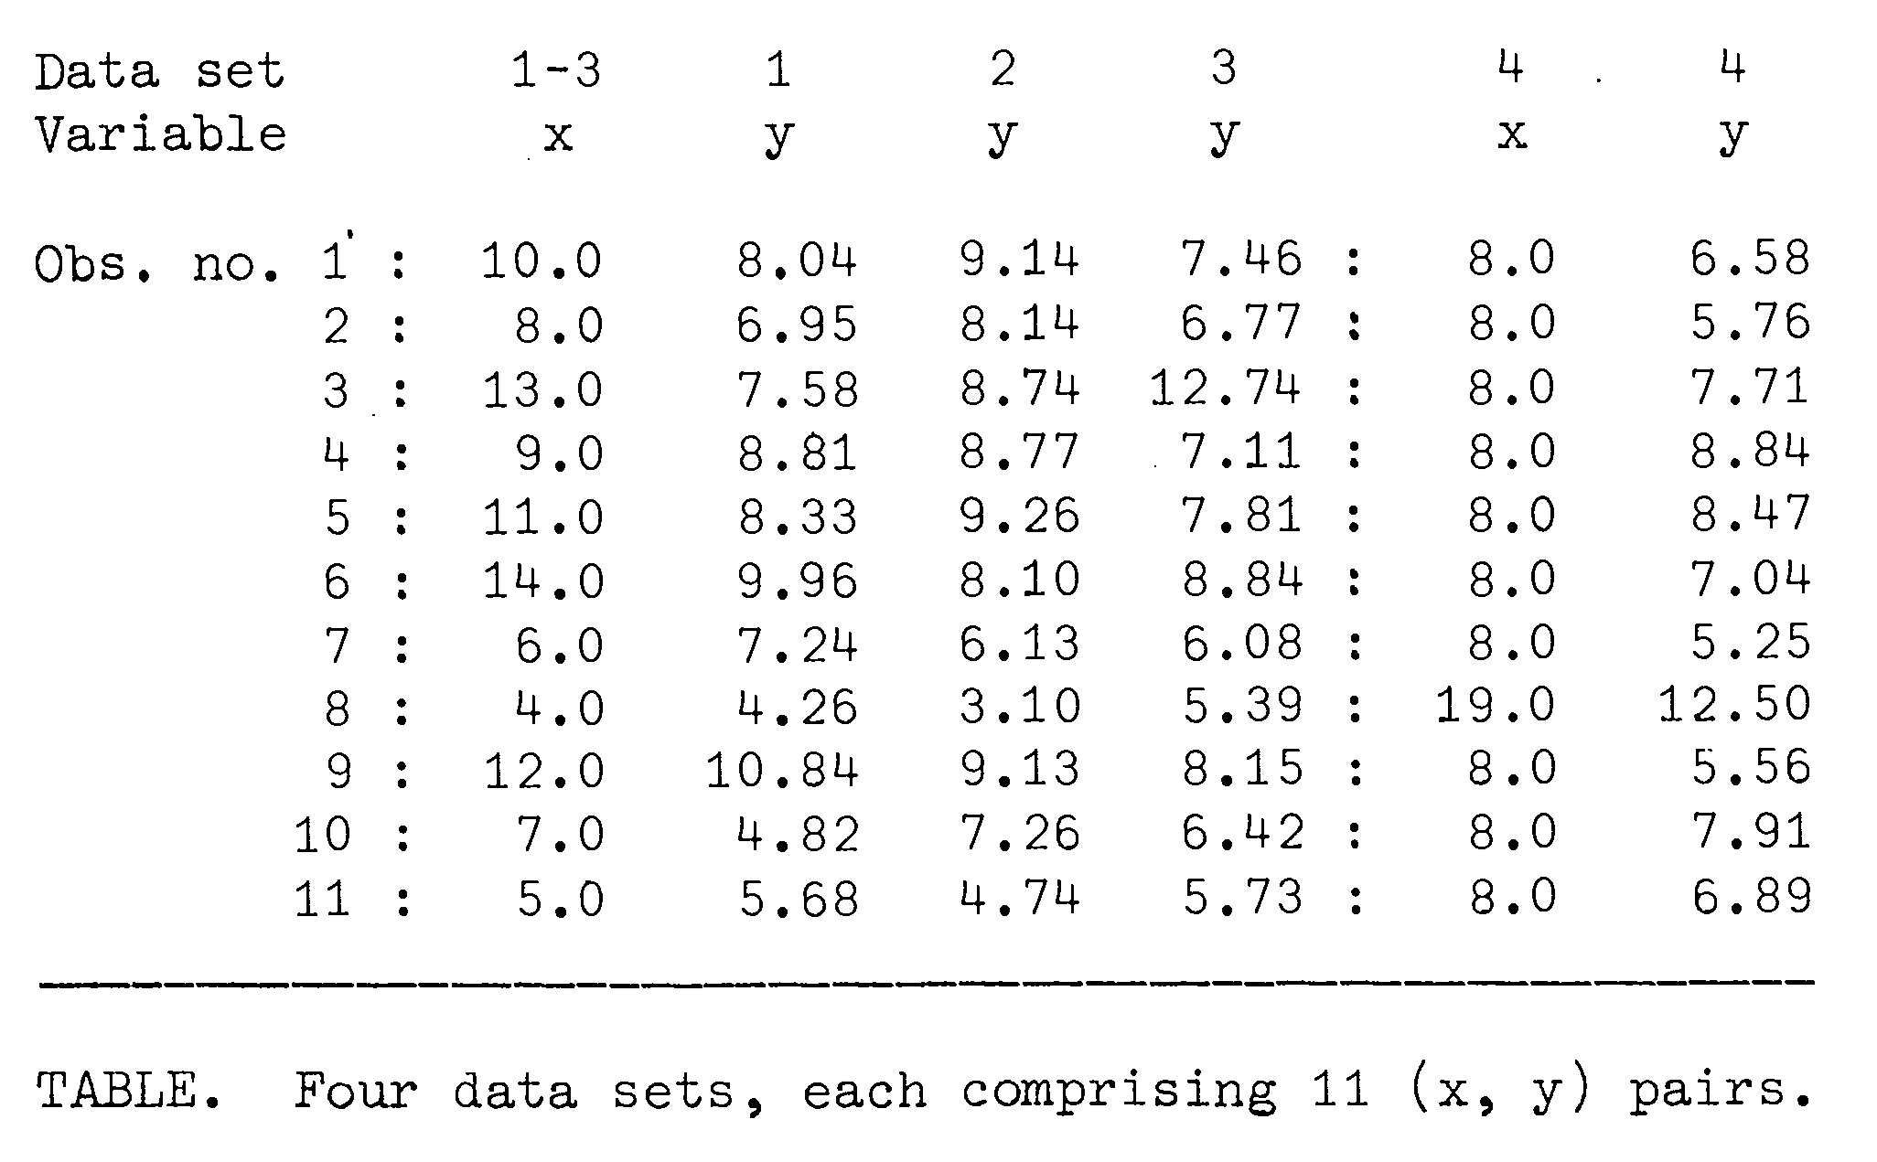
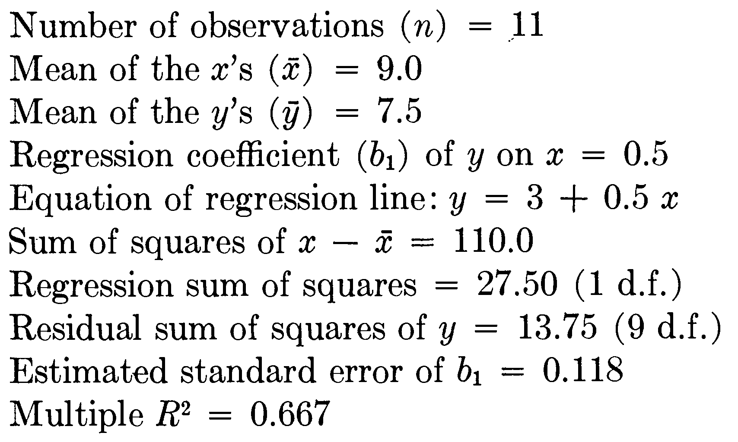
Anscombe’s Quartet
Graphs in Statistical Analysis. F. J. Anscombe. The American
Statistician, Vol. 27, No. 1. (Feb., 1973), pp. 17-21.
http://www.sjsu.edu/faculty/gerstman/StatPrimer/anscombe1973.pdf

Slide 4
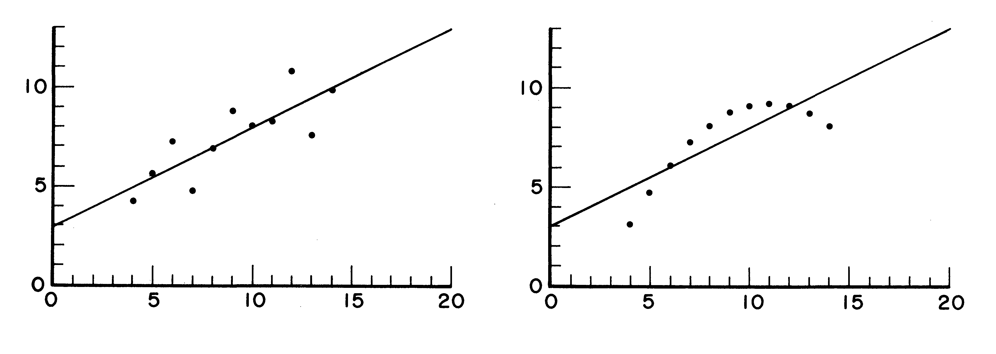
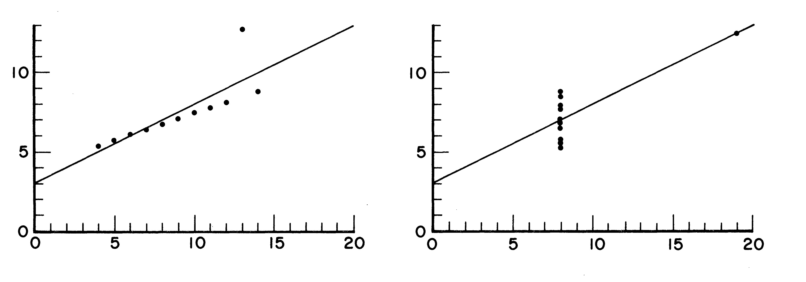

Slide 5
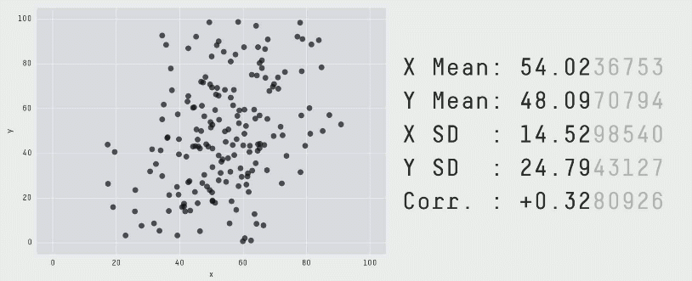
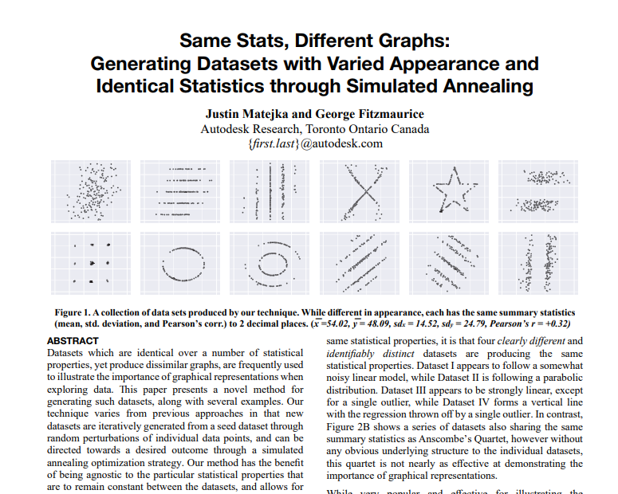
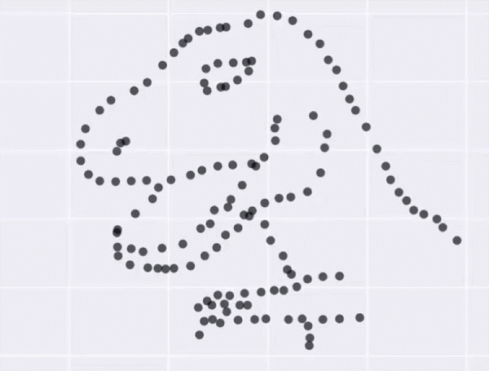

Slide 6
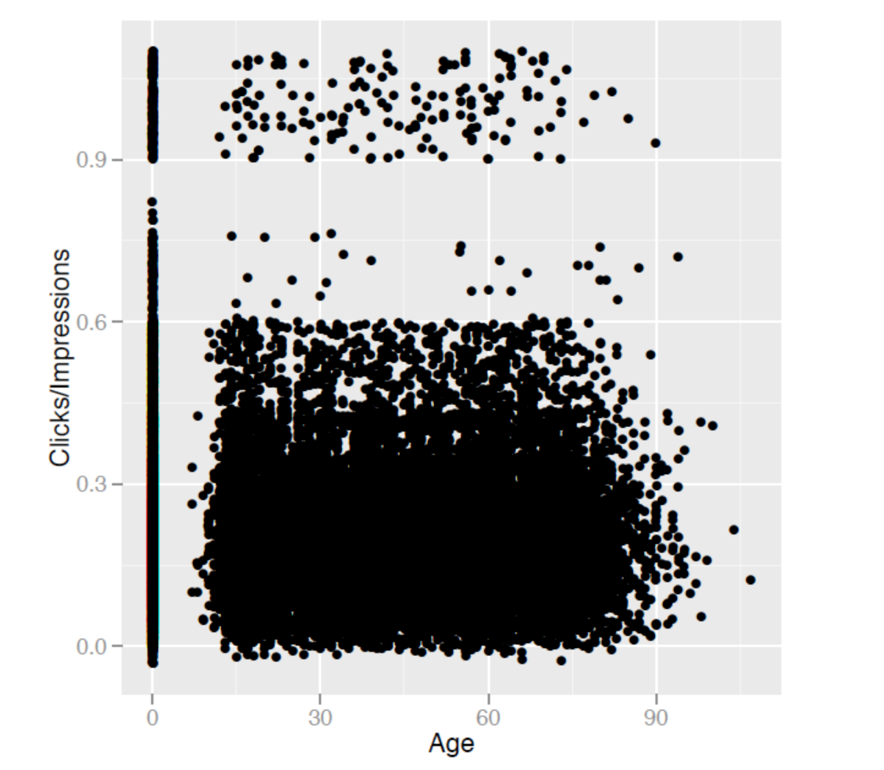
Problem #1:
We have too many data points to show

Slide 7
Histograms
Bar chart-based visualization that allows evaluating distribution of values.

Slide 8
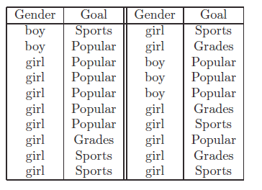
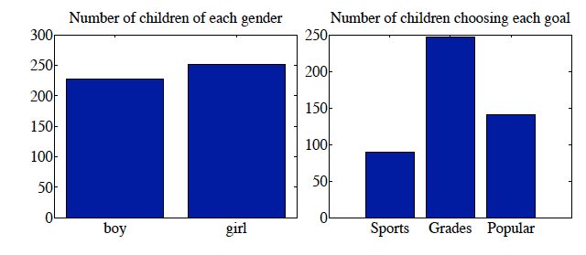
Categorical data

Slide 9
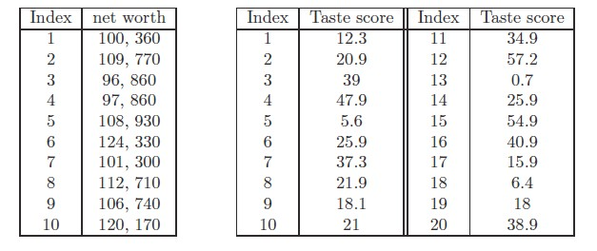
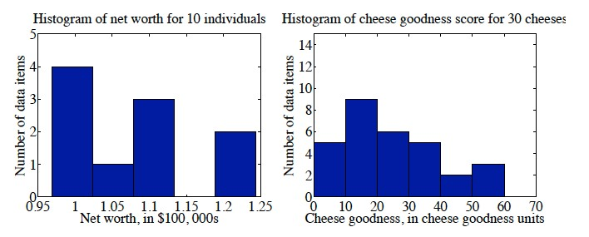
Continuous Data Histograms

Slide 10
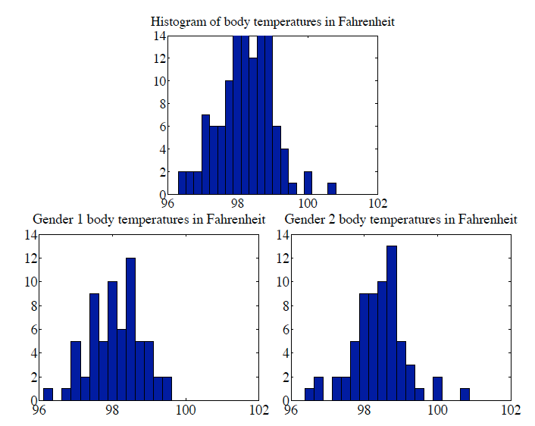
Conditional Histograms

Slide 11
2D Data

Slide 12
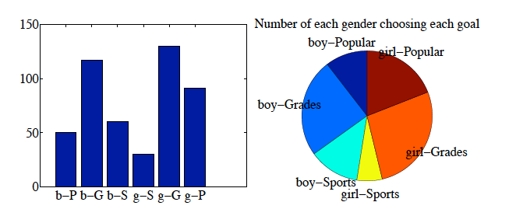
Categorical data

Slide 13
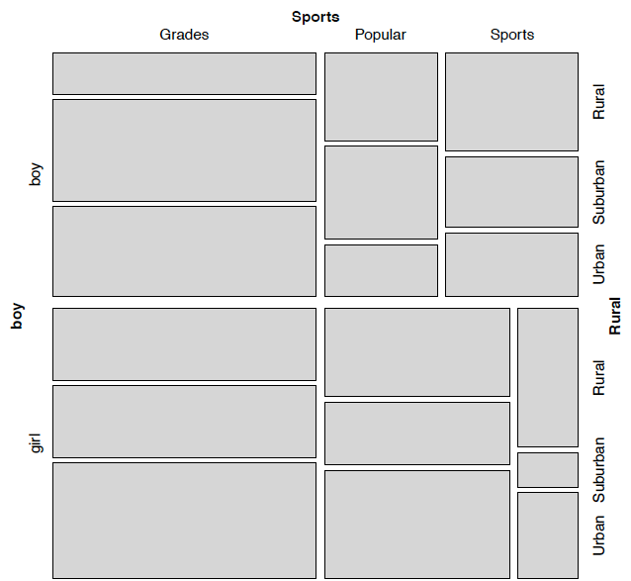
Mosaic Plots

Slide 14
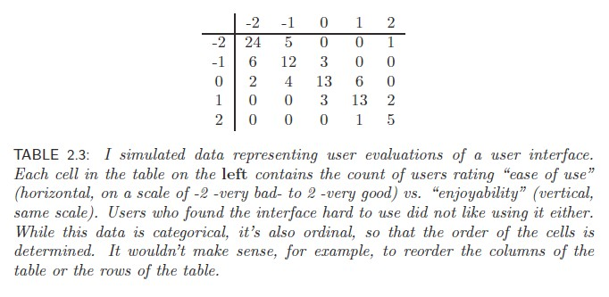
Ordinal data

Slide 15
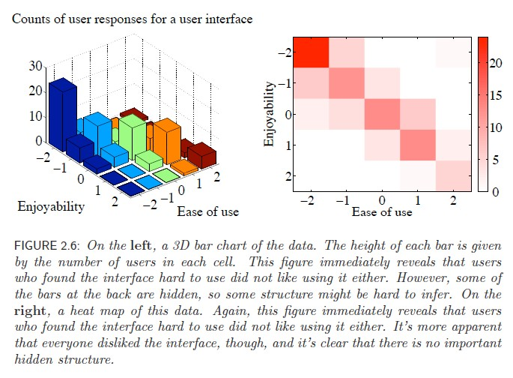
Ordinal data

Slide 16
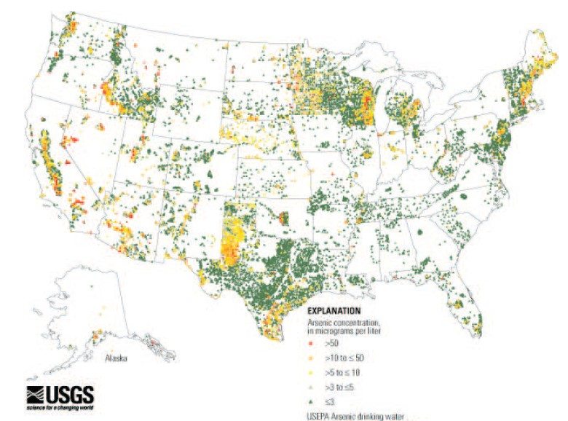
Arsenic in well water

Slide 17
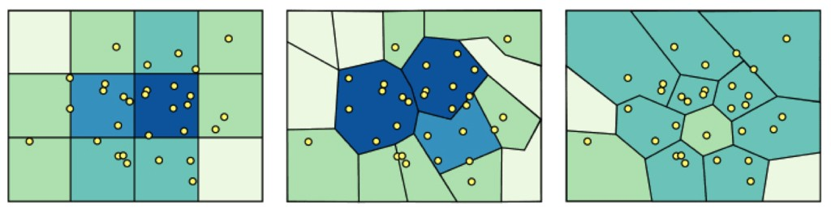
spatial aggregation
modifiable areal unit problem
in cartography, changing the boundaries of the regions used to analyze data can yield dramatically diﬀerent results

Slide 18
Modeling Data

Slide 19
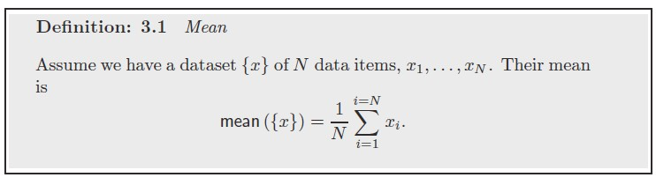
Summary Statistics – mean
The average
The best estimate of the value of a new data point in the absence of any other information about it

Slide 20
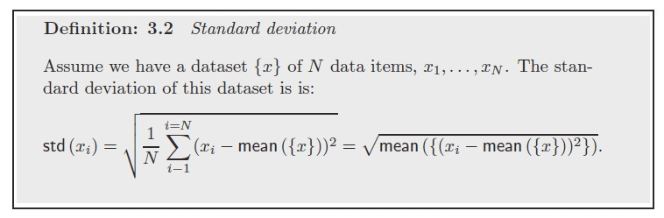
Summary statistics - Standard deviation
Think of this as a scale
Average distance from mean

Slide 21
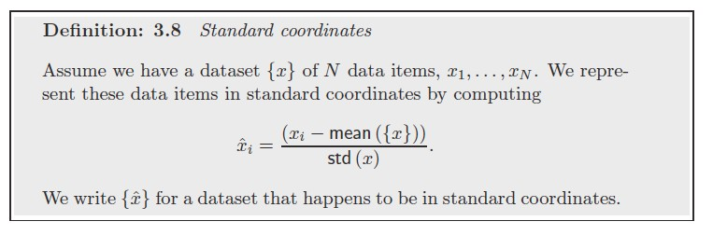
Standard Score (aka z score)
Number of standard deviations a point is away from mean

Slide 22
Mean
Z score

Slide 23
Normal Distribution

Slide 24
An Example: Histogram

Slide 25
An Example: Histogram Resolution

Slide 26
An Example: Statistical Distribution

Slide 27
An Example: Comparing Histogram & Distribution

Slide 28
An Example: Comparing Histogram & Distribution

Slide 29
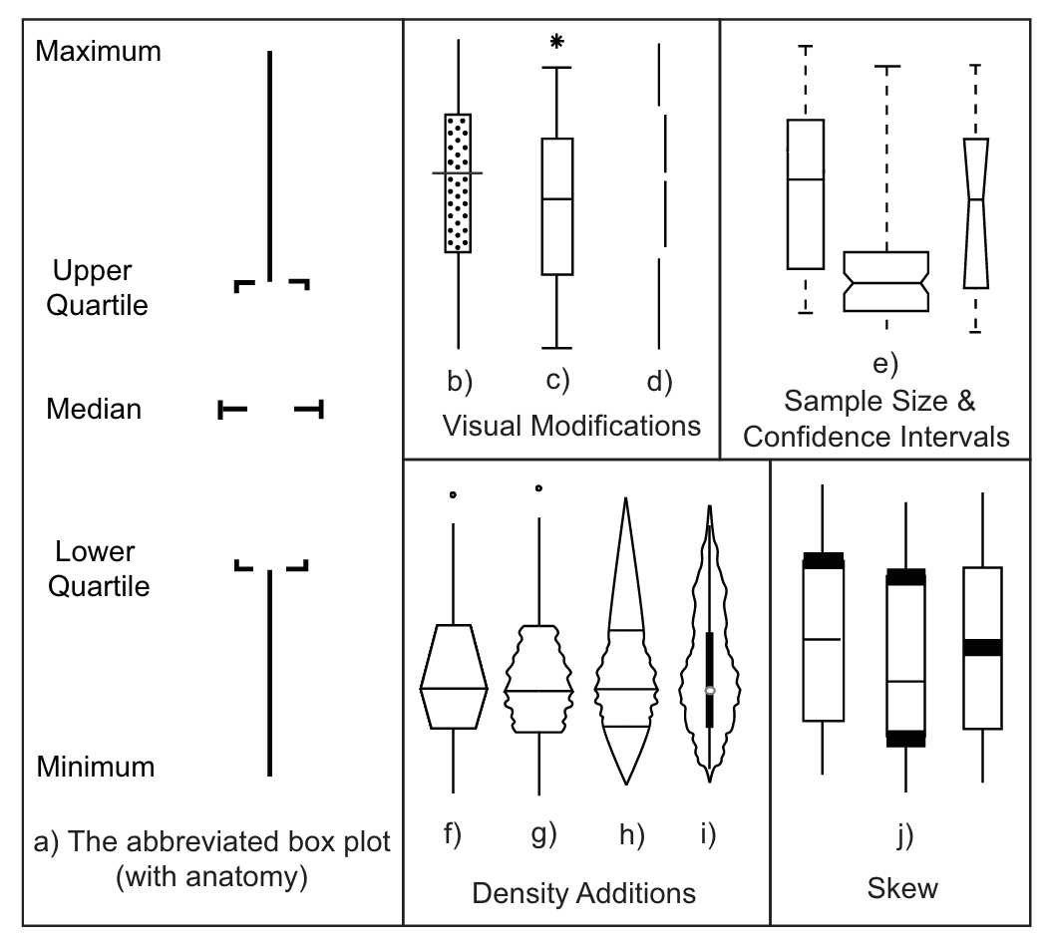
Boxplot
Potter et al., 2010

Slide 30
Boxplots
Potter et al., 2010

Slide 31
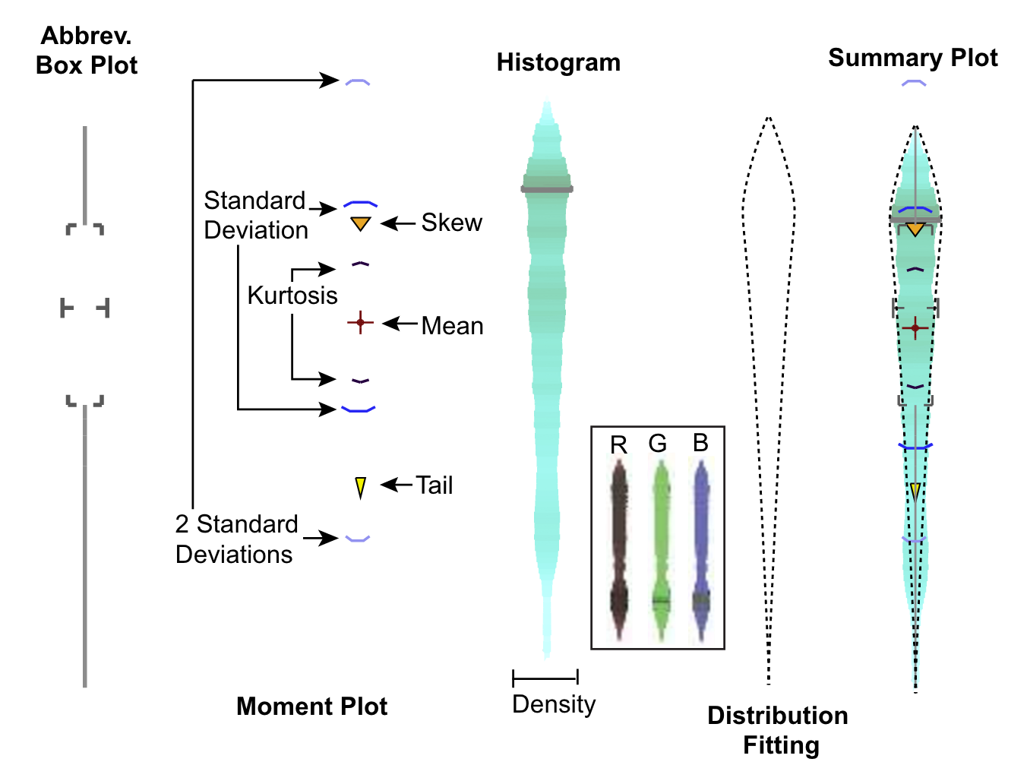
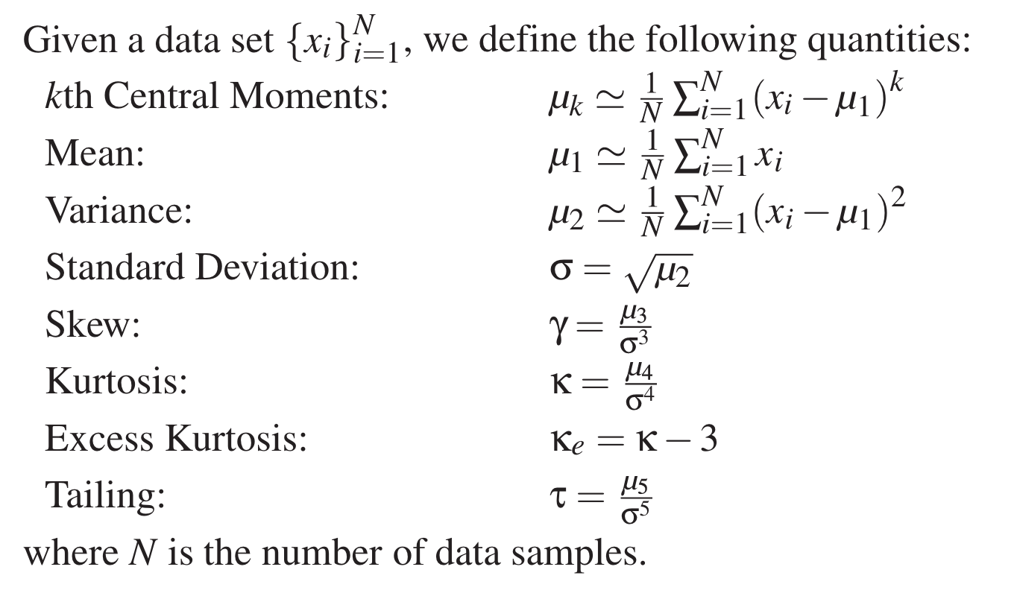
Boxplots
Potter et al., 2010

Slide 32
Problem #2:
We have too many attributes to show

Slide 33
Pearson Correlation Coefficient
A measure of the linearity between 2 sets

Slide 34
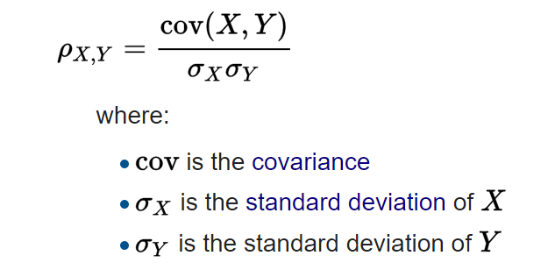

Slide 35
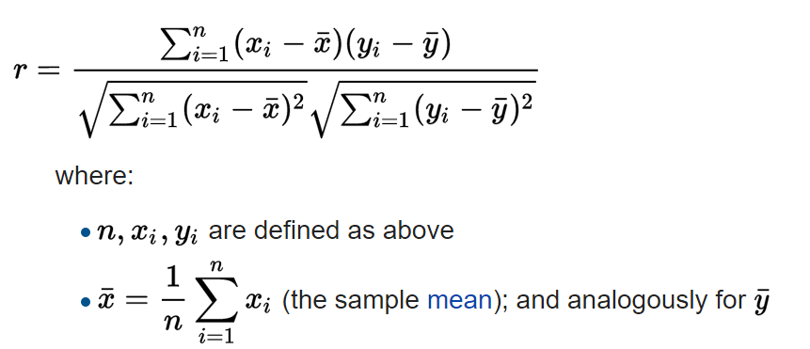

Slide 36
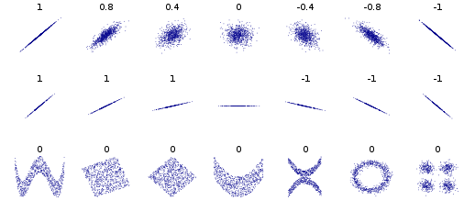

Slide 37
Spearman Rank Correlation

Slide 38
Spearman Rank Correlation
sort(X) and sort(Y)
assign X’/Y’ rank in sorted list
Calculate PCC( X’, Y’ )

Slide 39
Spearman Rank Correlation
IQ, (X) | Hours of TV per week, (Y) | rank (X’) | rank (Y’)
86 | 0 | 1 | 1
97 | 20 | 2 | 6
99 | 28 | 3 | 8
100 | 27 | 4 | 7
101 | 50 | 5 | 10
103 | 29 | 6 | 9
106 | 7 | 7 | 3
110 | 17 | 8 | 5
112 | 6 | 9 | 2
113 | 12 | 10 | 4

Slide 40
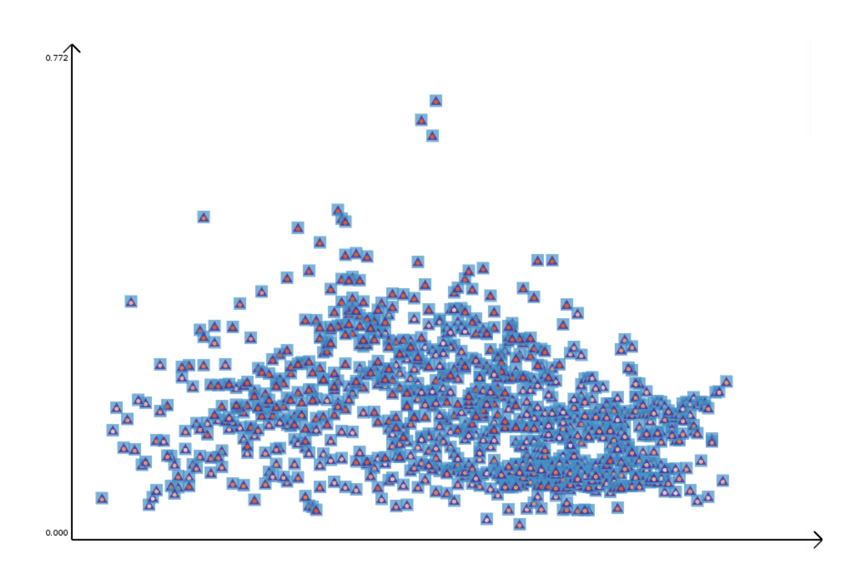
Many Attributes Multiple Correlation
Nguyen 2016

Slide 41
Multiple Correlation

Slide 42

Multiple Correlation
2-way
3-way
4-way
Composite Glyph
(6) 2-way
(12) 3-way
(4) 4-way
Nguyen 2016

Slide 43
Many Attributes Multiple Correlation
Nguyen 2016

Slide 44
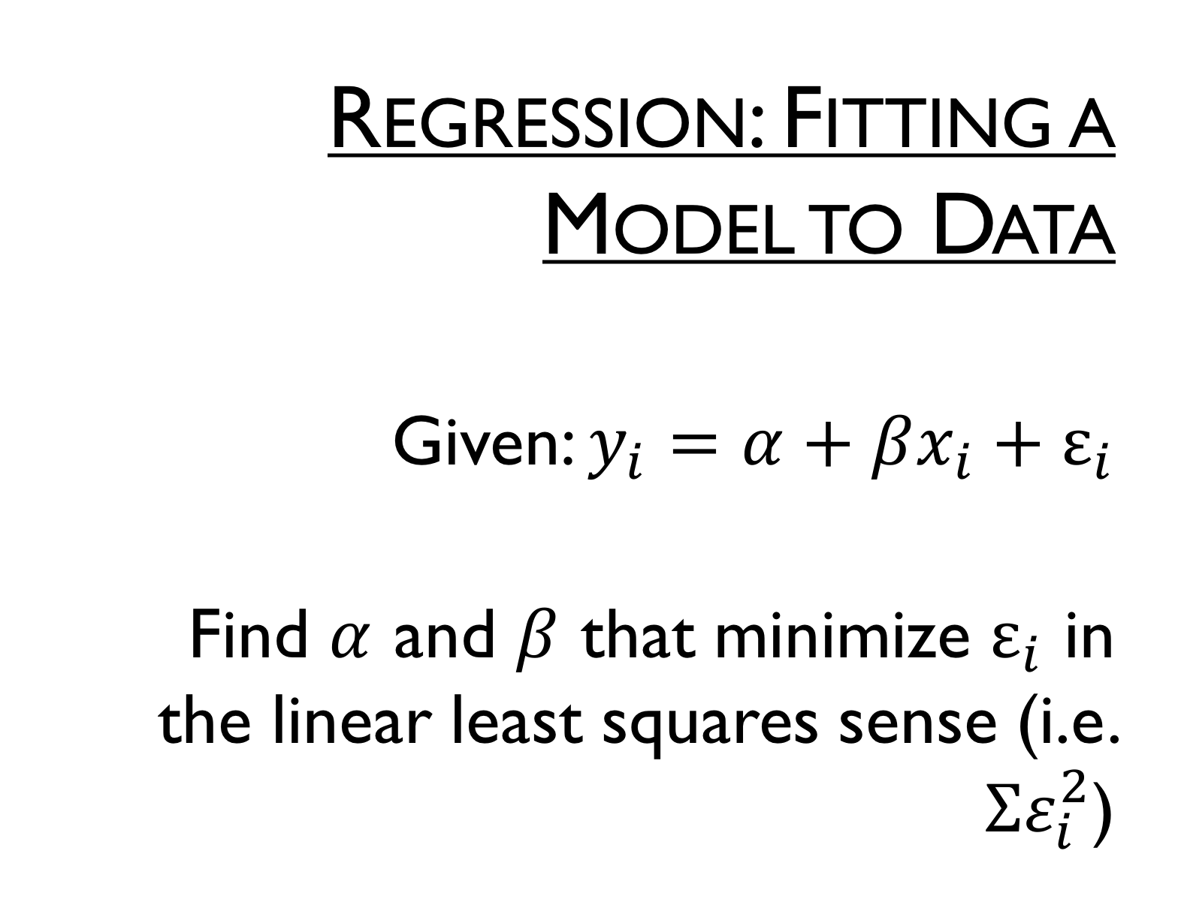
Regression: Fitting a Model to Data
Given: $y_{i}=α+βx_{i}+ε_{i}$
Find $α$ and $β$ that minimize $ε_{i}$ in the linear least squares sense (i.e. $Σε_{i}^{2}$)

Slide 45
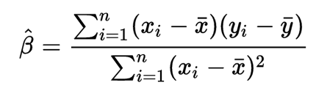
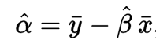
Regression: Fitting a Model to Data
Can be computed directly

Slide 46
Problem #3
What is lost or misinterpreted…

Slide 47
So, what’s the difference between Correlation and Regression and how does it impact our visualization?

Slide 48
Know the shapes (information) your statistic captures

Slide 49
Statistical Limitations
Anscombe's quartet
Notes:
Dataset I appears to have clean and well-fitting linear models.
Dataset II is not distributed normally.
In Dataset III the distribution is linear, but the calculated regression is thrown off by an outlier.
Dataset IV shows that one outlier is enough to produce a high correlation coefficient.

Slide 50
Statistical Limitations
Anscombe's quartet
Property | Value | Accuracy
Mean of x | 9 | exact
Sample variance of x | 11 | exact
Mean of y | 7.50 | to 2 decimal places
Sample variance of y | 4.125 | plus/minus 0.003
Correlation between x and y | 0.816 | to 3 decimal places
Linear regression line | y = 3.00 + 0.500x | to 2 and 3 decimal places, respectively

Slide 51
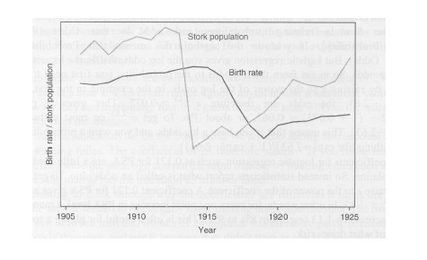
Correlation != causality
and foot size is positively correlated with reading ability, etc.

Slide 52
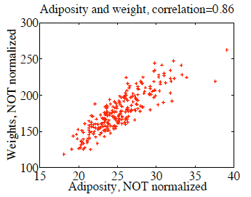
but can be used to predict

Slide 53
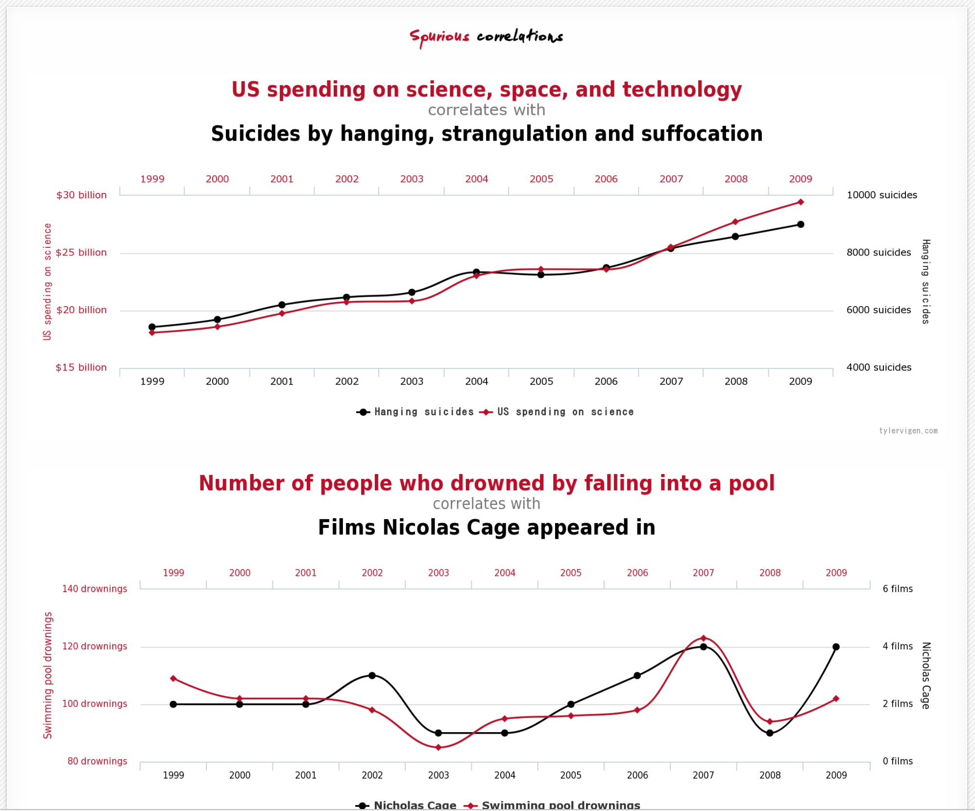
http://www.tylervigen.com/spurious-correlations

Slide 54
Statistical Vis Tools: R
It’s free
It’s easy to get pictures up and going
Many, many (almost too many) tools already available
Let’s you work with tools *without* implementing them. However, you should UNDERSTAND them.

Slide 55
http://students.brown.edu/seeing-theory/index.html

Slide 56
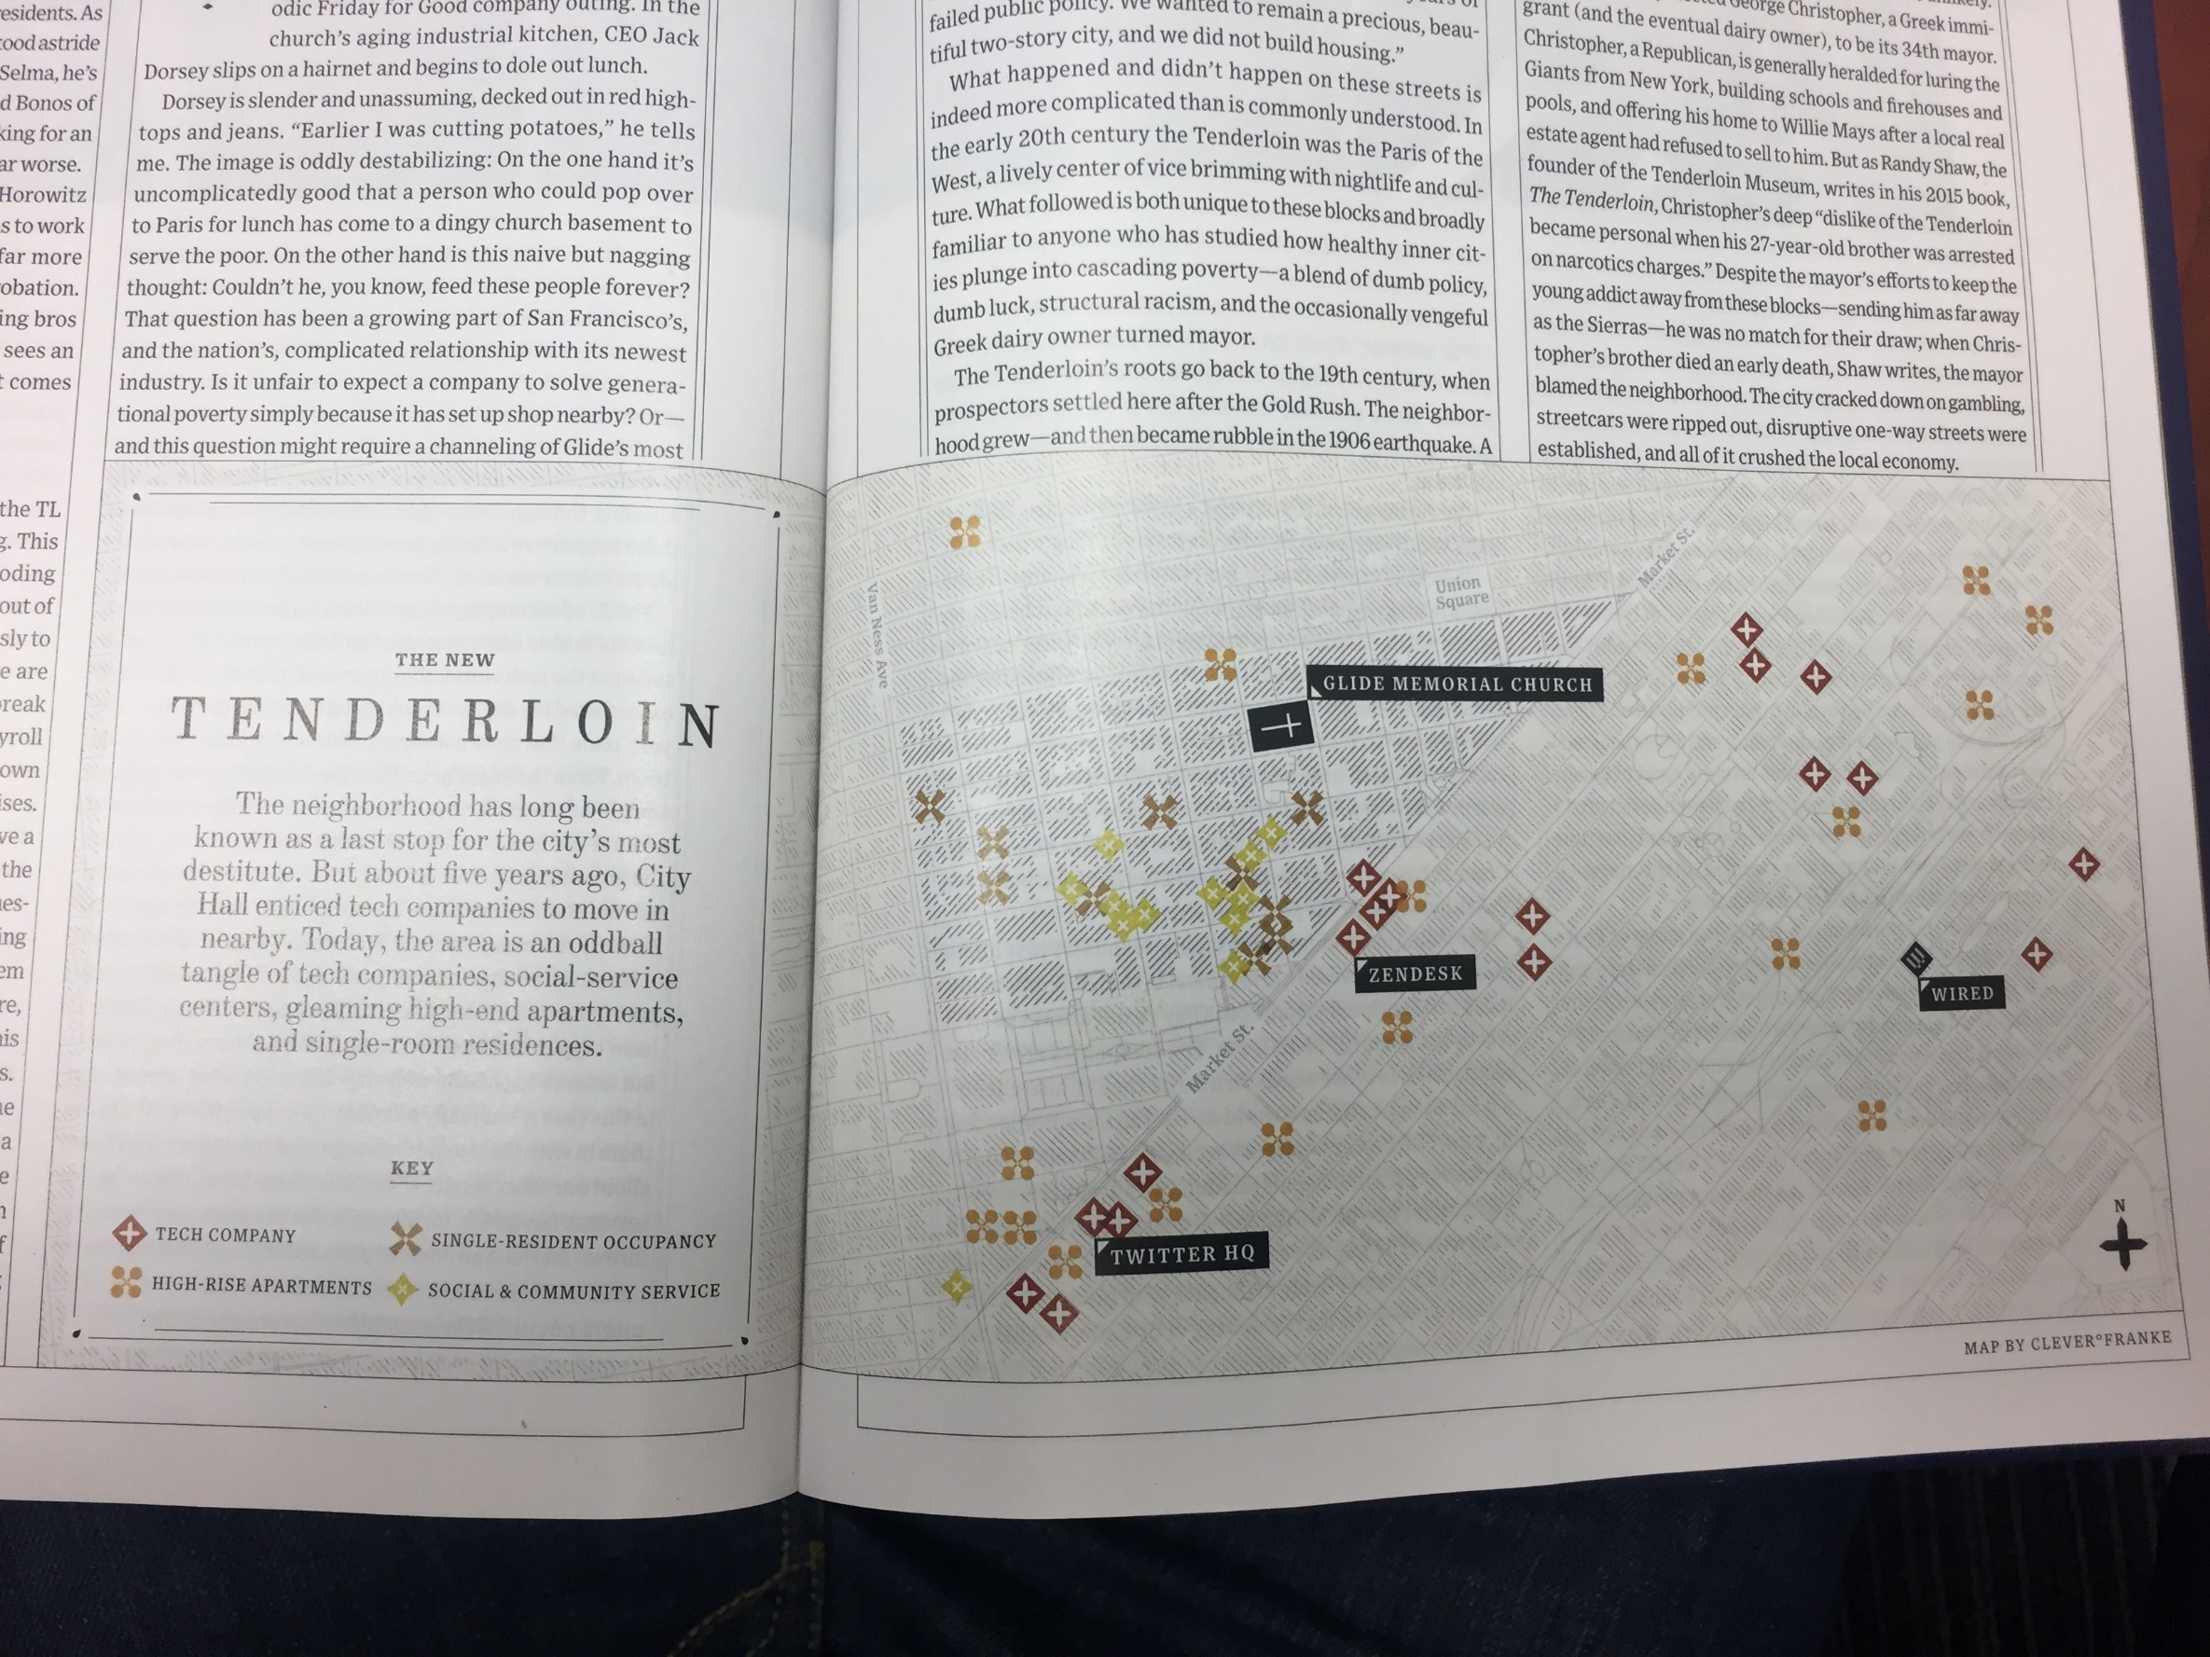
Wired, Jan 2017

Slide 57

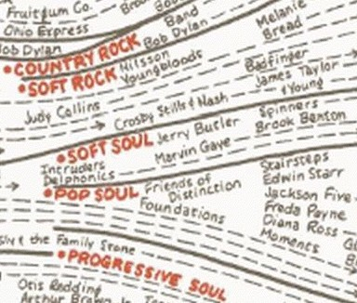
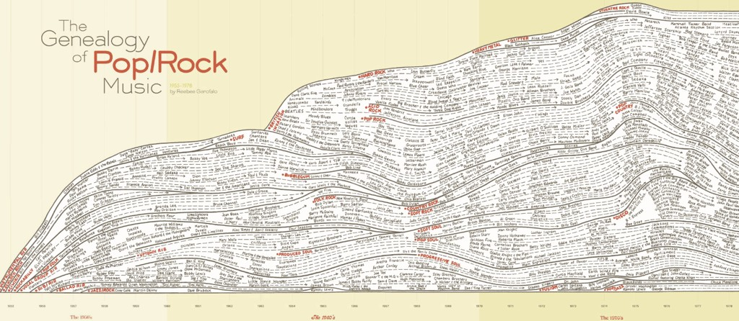
MAXIMIZE AMOUNT OF DATA SHOWN
Steve Chappel and Reebe Garofalo
in Rock 'N' Roll is Here to Pay: The History and Politics of the Music Industry, 1977

Slide 58
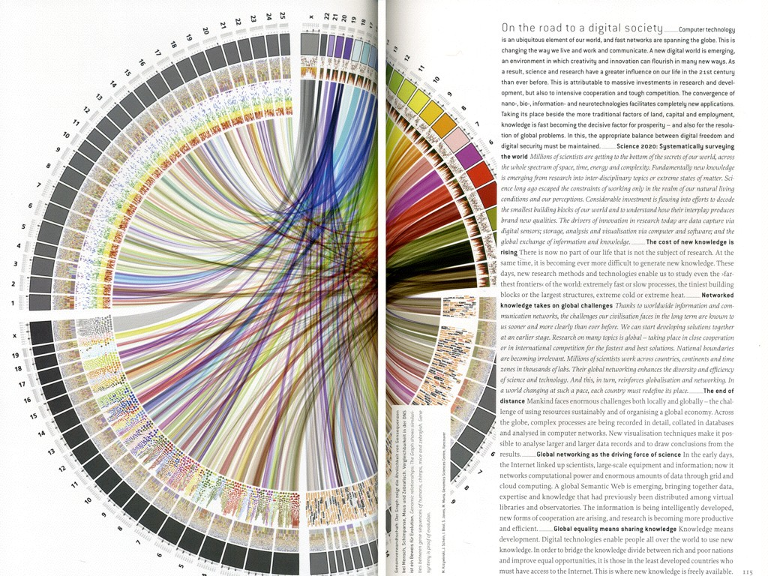
71
Science Express: How Science and Technology change our life. Herausgegeben von der Max-Planck-Gesellschaft

Slide 59
Questions

